Slide 1


The Power of Together

Slide 2
What did you do during the
Great Transition?

Slide 3
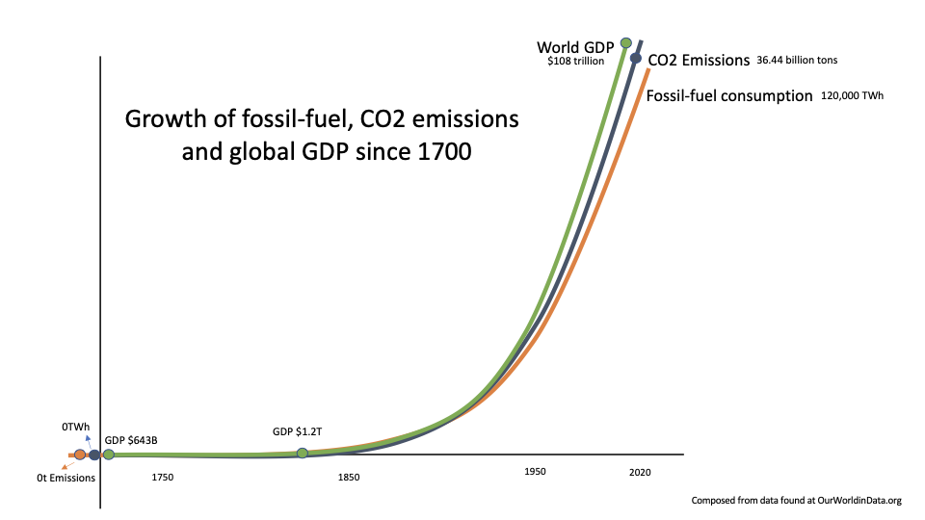
Our CO2 emissions and the expansion of global wealth have followed the identical diffusion path as fossil-fuel consumption.
Fossil-fuel has enabled our modern way of life.
The work for the next 20 years is to decarbonize energy systems by adopting more efficient, cleaner, safer, and sustainable technologies while continuing economic growth.
This will be the most demanding and fast change in human history.
Notes:
For me, this chart says everything. Since the 1850s at the advent of fossil fuel and the internal combustion engine - the growth of fossil-fuel use has driven GDP, while at the same time producing an invisible pollution - CO2 emissions - the source of climate change. In the last 5 extinctions on earth - every single one was caused by too much carbon in the atmosphere. This is the first time, it has been caused by humans.
What have we done with all those rich electrons? We have produced stuff. And, lots of it. The trick will be to remove carbon and continue to provide a pathway to sustainable wealth.

Slide 4
Grand Challenge
Design the energy and power systems of the future as if creating the conditions for our grandchildren’s children to thrive.

Slide 5
Remove carbon from our power, buildings, and transportation systems to provide 75% of the reduction in CO² emissions that we need to stay below 1.5°C
Notes:
These are our marching orders.

Slide 6
Design Challenge
Not enough time
Not enough resources
We need interoperability
And, no vendor lock-in
Notes:
These are our marching orders.

Slide 7


Providing a 21st century plan of action to decarbonization through open source, open frameworks, reference architectures, and a support ecosystem of complementary projects.
Notes:
Talking Points:
- LF Energy is taking the power of Linux and focusing it on energy
But why do we exist?
Because in energy we now face similar conditions as those examples we discussed in the private sector.
We now must exist in an open source economy

Slide 8

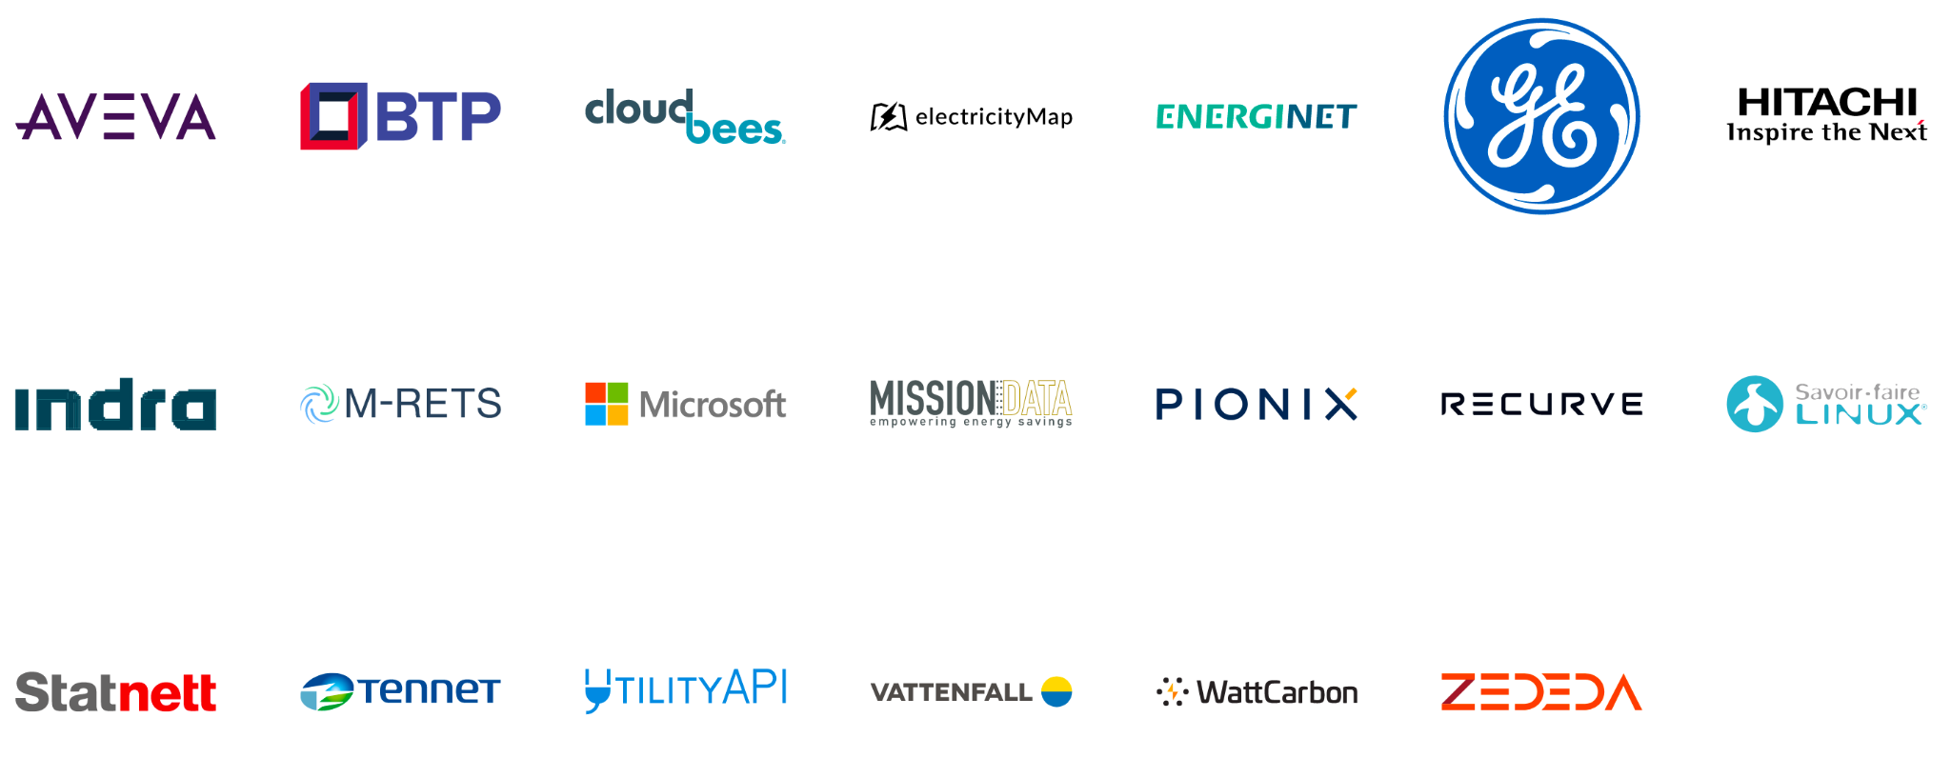
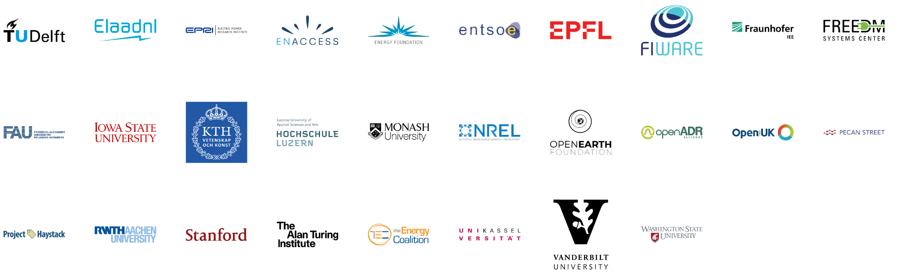
LF Energy Members
Strategic
General
Associate
Notes:
36 members and counting
Source: https://landscape.lfenergy.org/pages/members

Slide 9

Notes:
Linux Has Grown into the Most Important open-source Platform in the World
To enable all of this the world has made two massive shifts:
Open source technology
Collaboration for non-differentiating layer
At the heart of the Linux Foundation is governance - a light-weight legal framework that enables joint investment. Separates business from technology. And through transparency, enables competitiors to work together in the open on creating the next paradigm.

Slide 10







The world’s dominant open source platform.
100%
82%
2nd
90%
90%
62%
#1
Supercomputer Market
Smartphone Market Share
To Windows in Enterprise
Mainframe Customers
Public Cloud Workload
Embedded Systems Market
Internet Client
Notes:
Talking points:
Linux leads in all industries it enters- including having 100% of the supercomputer market and 90% of the public cloud workload
It has a massive and proven positive impact on its members

Slide 11






A new member joins The Linux Foundation every day.
$54.1B
242,960+
100%
420+
1900+
Shared Value
Developers Contributing Code
of Fortune 100 Tech & Telecom
Open Source Projects
Members From 70 Countries
Notes:
TRIED AND TRUE.
FOLLOW THE BEST COMPANIES IN THE WORLD
Faster
cheaper
more secure

Slide 12












LF Energy: part of The Linux Foundation ecosystem of sustainable open source
For the last 16 years, The Linux Foundation has provided unparalleled support for open source communities through financial and intellectual resources, governance structure, IT infrastructure, services, events, and training.
Dedicated to building sustainable ecosystems around open source projects, The Linux Foundation is working with the global technology community to solve the world’s hardest problems through open source and creating the largest shared technology investment in history.
The Linux Foundation is the umbrella organization for more than 425 open source projects accelerating open technology development and commercial adoption. Some of the game-changing initiatives hosted by The Linux Foundation include:
Notes:
See more details here: https://www.linuxfoundation.org/join/#benefits

Slide 13



























































































Our projects span a range of technologies and vertical industries
Security
Networking
Cloud
Automotive
Blockchain
Edge/IoT
Web
AI
Film
CI/CD
Energy
Hardware
Standards

Slide 14
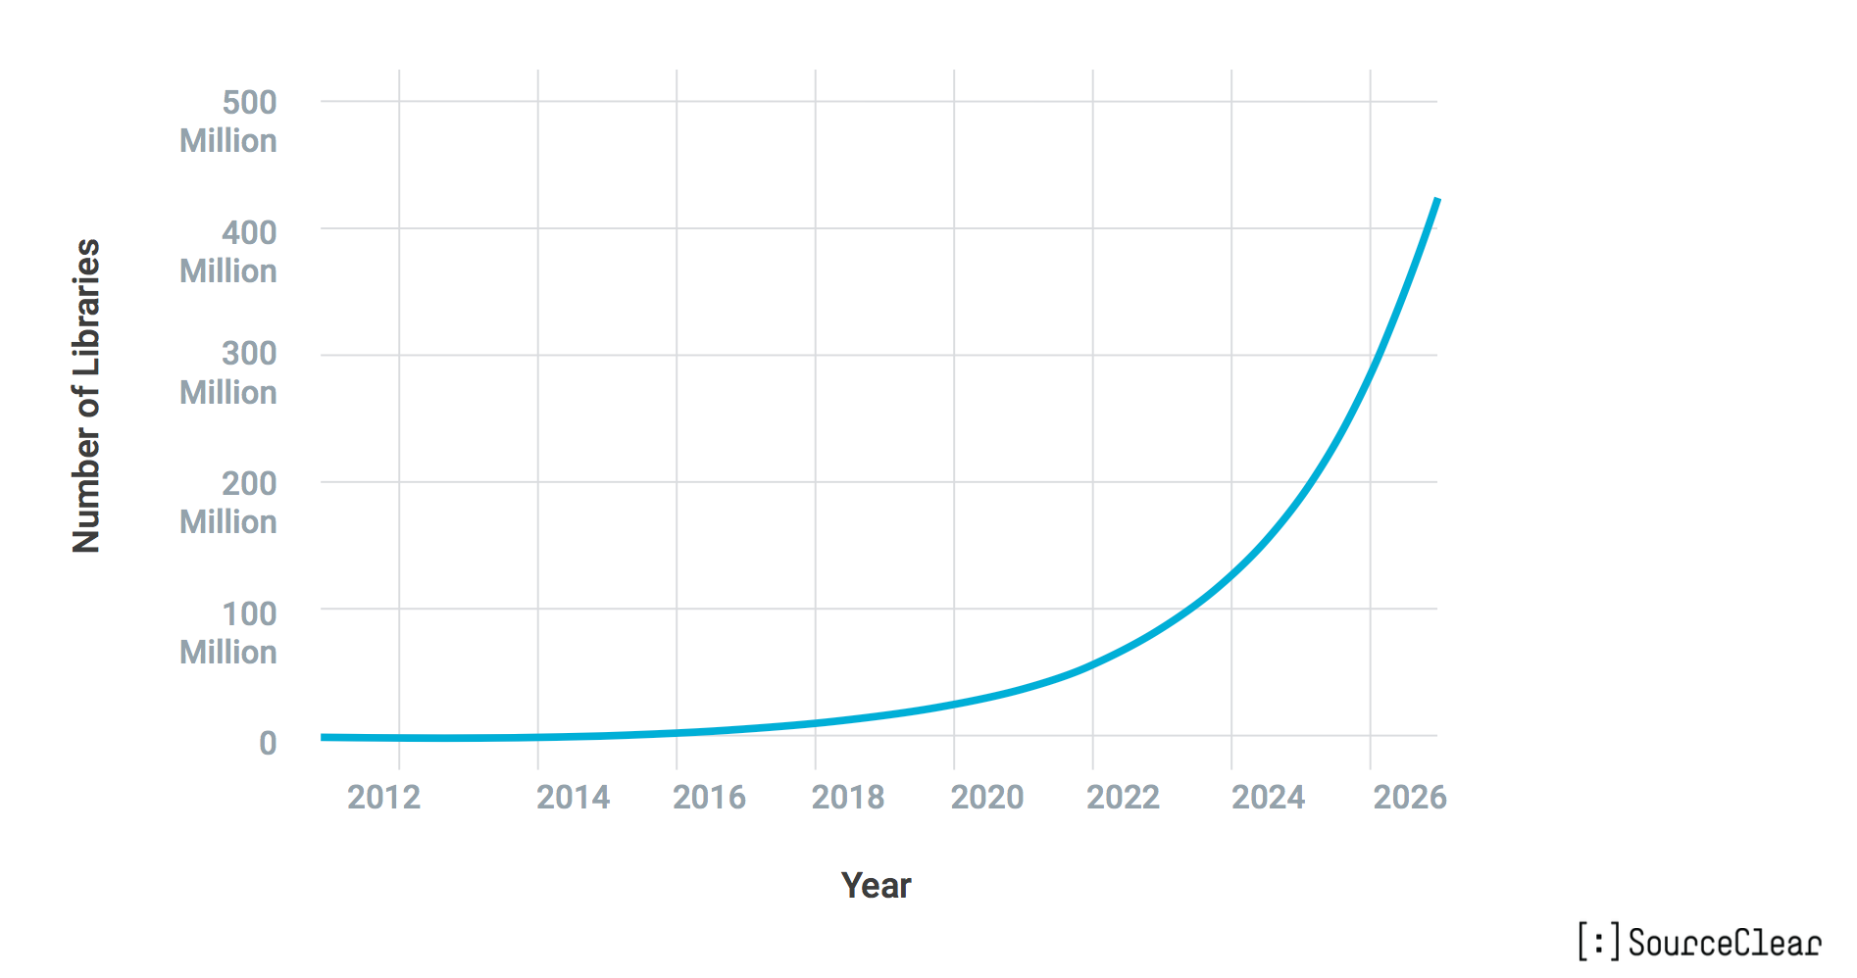
Open Source Isn’t Slowing Down Any Time Soon

Slide 15
The real question is: Which projects really matter?
Value of Individual Project
Number of Open Source Projects

Slide 16
Linux Foundation seeks to accelerate new projects to adoption and sustainability
Build Ecosystems
Critical and high value projects
Value of Individual Project
Number of Open Source Projects

Slide 17


AT&T saved $1.6B through dis-aggregation
In 12 months 80% of the worlds telecom subscribers (~3.5 billion people)
$576M of shared development by +2,500 developers.
Reduced deployment from six months to 15 minutes.
Notes:
Talking points:
An example of Linux at work in the AT&T ONAP project- where $576M of shared development occurred by 2,500 developers.

Slide 18


Five of Top 10 Automakers aligned and account for 70% of the worldwide vehicle shipments.
130+ Members
Nine Major OEMs and their entire supply chains participating
Notes:
Talking points:
In the auto industry 5 of the top 10 automakers are part of Automotive Grade Linux which has 130+ members in total.

Slide 19


530 Members
Kubernetes de facto standard for container management
Home to 25 additional projects beyond Kubernetes
75 Kubernetes certified providers including 10/10 top public clouds
Notes:
Talking points:
In the cloud native computing foundation Kubernetes has become the defacto standard for container management, thanks to Linux

Slide 20









Compete on Products & Services
Leveraged Development &
Open Source Software Ecosystem
Marketplace
20%
80%
Marketing
& PR
Leadership &
Support
Training & Talent
Security
IP Legal Support
Global
Events
Membership Benefits
Badging & Certification
We insure the neutral ecosystem. Collaborate and form strategic relationships across key stakeholders.
Promote your innovations and share definitive action to ALL stakeholders. Gain leading-edge insights, driving faster/better ME&O.
Access to top talent and training. Expand your resources cost effectively. Develop deeper understanding of specialized subject matter.
Global strength testing; beyond what any one in-house team can do. Surface and drive enhanced cyber security doctrine through insights.
Elevate the skills of your team and keep them engaged with emerging breakthroughs.
Removes IP ownership issues and costs.
Access to global thought leaders and influencers. Seamlessly transitioned to virtual events.
Notes:
Talking Points:
- This is a small glimpse into what you have access to as a LFE member.
- Talk to us and we can show you just how much more you have access to

Slide 21
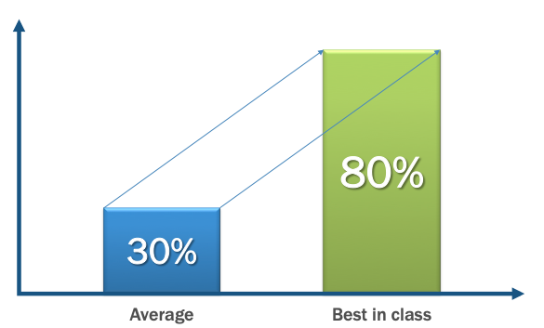
Open source software is a strategic asset
Shift from smaller part to majority of code being open source across industries: Embedded, Supercomputing, Telecom, Finance, Healthcare, Entertainment, Automotive, and ENERGY!

Slide 22
Open source software is a market accelerant
Standardization on open technologies
Neutral environment for collaboration & cross-pollination
Innovation multiplier
Enables better interoperability
Minimizes fragmentation
Qualifies reference architectures
Lowers barriers to enter a new domain
Enables new business opportunities
Leads to better products
Allows shared cost of development
22

Slide 23

The LF Energy ecosystem alleviates the cost, risk and stagnation of isolated solutions.
We take you beyond “black boxes”.
Notes:
Talking Points:
Reduces cost, risk and the damage caused by isolation.
Collaborate on the 80% that doesn’t differentiate and demands the most of your resources
Focus on the 20% that truly moves you forward and allows you to innovated for your stakeholders and customers

Slide 24
Projects

Slide 25













LF Energy Projects (+3)
Notes:
Plus another 3 by the end of the month.

Slide 26
The future is shared
technology innovation!

Slide 27
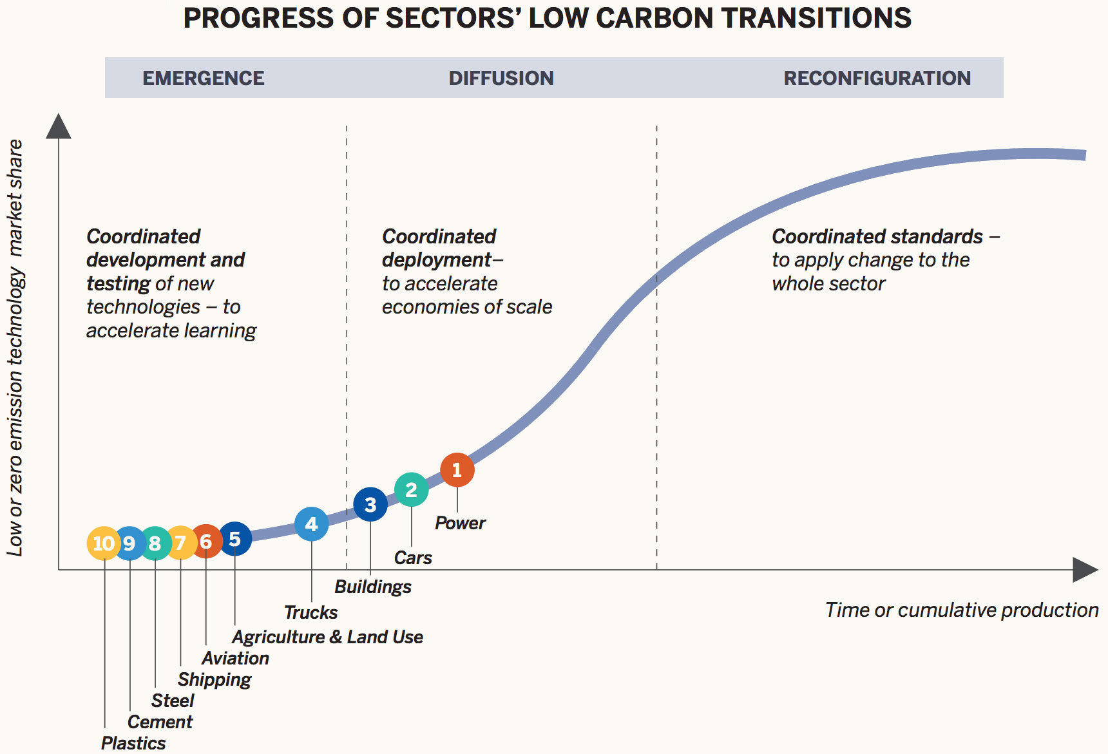
Power systems lead global decarbonization efforts
Notes:
Remove carbon from our power, building and transportation systems to provide
75% of the reduction in CO2 emissions that we need to stay below 1.5°C

Slide 28
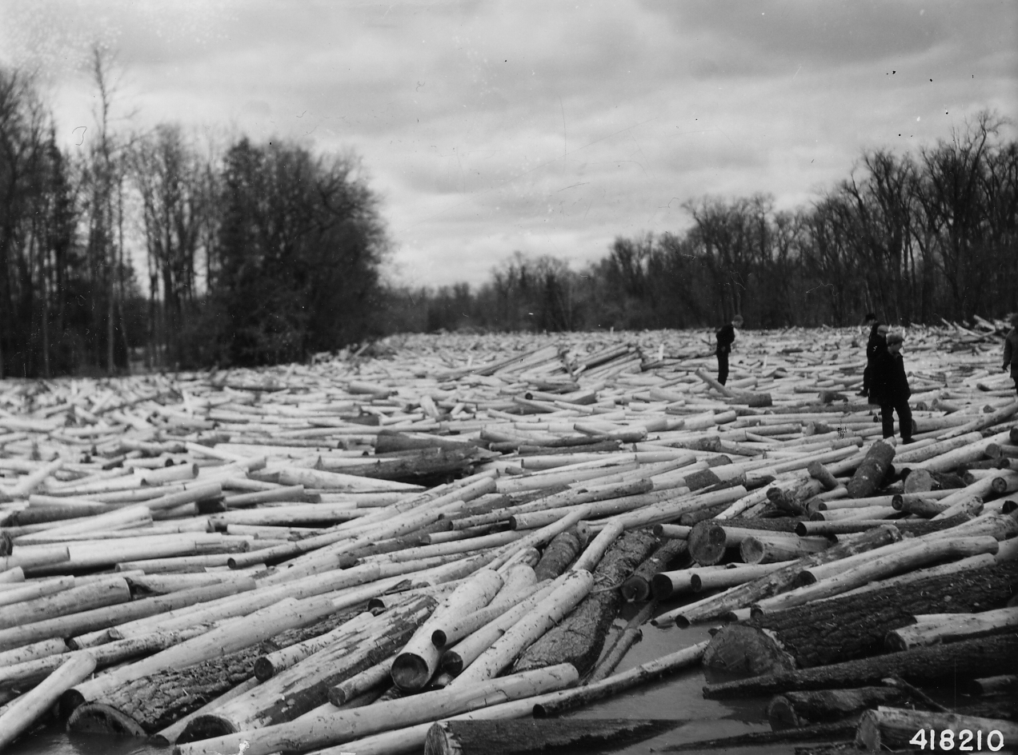
Notes:
But, I’ll be honest - the energy sector is a modern day version of a logjam. Stuck. Slow. And unmoving. Yet we must learn to move at the speed of technology.
The thing about a logjam is that you cannot delicately pick it apart.
The way you clear a log jam is with dynamite.
I want to talk with you not just about what LF Energy is, but what we must become if we all work together.
Energy moving at the speed of technology and the urgency we face is our CALL to ACTION.
2021 is the year that the rivers begin to move again.
You all are the gathering of the firstline and essential workers who are foremost necessary in global decarbonization efforts.

Slide 29
Call to Action
Notes:
We are at the very beginning of a tremendously ambitious human agenda.

Slide 30

VISION:
The grid of the future is composed of loosely coupled systems that are resilient, manageable, and observable. Combined with robust automation, the digitalization of energy enables engineers and markets to make high-impact changes frequently and predictably with minimal toil.
MISSION:
The LF Energy Foundation’s mission is to accelerate the energy transition by fostering and sustaining an ecosystem of open source, vendor-neutral projects.
We democratize state-of-the-art patterns to make these innovations accessible for everyone.

Slide 31
We are building a grid that is beyond our ability to intellectually “manage”

Slide 32
50% of the effort of the energy transition is digital
Energinet, Danish TSO - 2020

Slide 33
80% of the software will be
open source
The Linux Foundation has found this to be true across their projects

Slide 34
40% of the effort of
decarbonization
will be open source
Notes:
That is why we are all here today.

Slide 35
Isolation and going it alone are no longer viable.
Notes:
Talking points:
There once was a time when it made sense to build a fortress around your business
It was safer, easier, cheaper and you had most of the resources your needed
It’s not affordable or feasible anymore
These companies and hundreds of others have recognized this and are now collaborating for the first time

Slide 36
We need speed, scale, enhanced security, accelerated innovation, and global talent.
Notes:
Talking points:
While the most credible ideas for the future may seem ridiculous today, they saw a need for tangible progress:
They understood they needed to move faster, drive greater impact, with heightened security to accelerate innovation- while having the right talent.

Slide 37

We need mass collaboration.

Slide 38
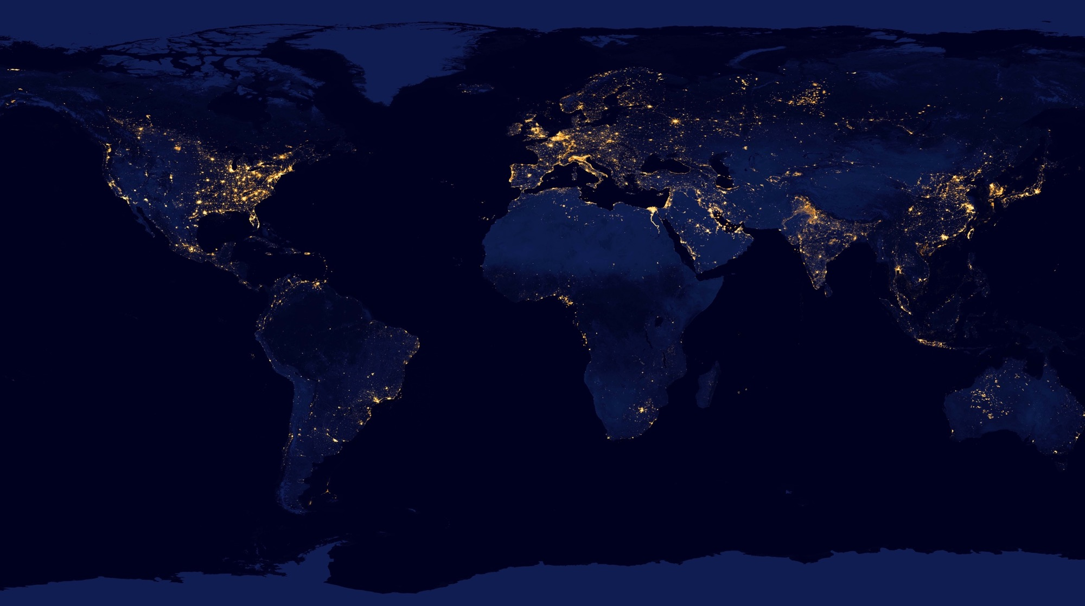
OUR COMMITMENT
To achieve our climate and energy transition goals we have joined together to create a common functional architecture defining a fit-for-the-future grid. Our goal is a common understanding of required functional capabilities. The architecture starts with a top-level view and progresses to a finer granularity. The final slide shows existing and near-future LF Energy projects fits into this architecture.
This is a start. We want your feedback and involvement. With this we proclaim a commitment under LF Energy to find shared strategic dependencies. By utilizing open source we can accelerate a technology revolution that enables rapid decarbonization by digitalizing the global energy grid. We see that cooperation and working together is the only path to individual and collective success.
Join us.

Slide 39
CUSTOMER & MARKET
SYSTEM MANAGEMENT
Capabilities related to customer and markets and other third parties
Capabilities related to managing the physical flow and balance of a power system
This is the top-level view that shows the five main “blocks” of the functional architecture that we also call categories.
Capabilities that are required by each of the other categories
SHARED
Capabilities related to monitoring and controlling your assets on the grid
Capabilities related to managing your assets
ACQUISITION AND CONTROL
LFE High-Level Functional Architecture V1.0 - CC 4.0
ASSET MANAGEMENT
Notes:
What follows is a three level taxonomy. A mental model of the grid of the future.

Slide 40
CUSTOMER & MARKET
SYSTEM MANAGEMENT
METERING & COMPENSATION
The capabilities related to engaging with customers, markets and other third parties
The capabilities related to managing the physical flow and balance of a power system
CUSTOMER RELATIONSHIP & COMMUNICATION
CUSTOMER RESPONSE
MARKET PLATFORM GATEWAY
MARKET SIGNAL
SYSTEM CONTROL
POWER SYSTEM CALCULATION
FORECASTING
DATA MANAGEMENT
SYSTEMS GOVERNANCE
IT MANAGEMENT
SUPERVISION
COMMON COMMUNICATION MEDIA
EDGE NODE CONTROL
OUTAGE MANAGEMENT
ASSET INVESTMENT PLANNING
SHARED
The capabilities that are required and shared by each of the other categories
LESS CRITICAL EQUIPMENTS
SECURITY MANAGEMENT
UNIFIED OPERATOR’S UX COMPONENTS & FRAMEWORK
AGGREGATION
NODE
CENTRAL HUB
SUBSTATION
NODE
ASSET REPOSITORY
ASSET SUPERVISION
ANALYTICS
FIELD WORK MANAGEMENT
DISTRIBUTED
NODE
COMMUNICATION INFRASTRUCTURE
CRITICAL EQUIPMENTS
INFRASTRUCTURE MANAGEMENT
EQUIPMENT
NODE
The capabilities related to monitoring and controlling your assets on the grid
The capabilities related to managing your assets
EQUIPMENT
NODE
ACQUISITION AND CONTROL
LFE High-Level Functional Architecture V1.0 - CC 4.0
ASSET MANAGEMENT

Slide 41
This is the framework for what will become the LF Energy Application Catalogue
CUSTOMER & MARKET
SYSTEM MANAGEMENT
CUSTOMER RELATIONSHIP & COMMUNICATION
Acquisition, system design, pricing
Notification & communication management
Emergency & crisis management
Customer app/UX/UI
Contract
Consent management
METERING & COMPENSATION
Metering
Compensation/ Settlement
Billing
CUSTOMER RESPONSE
Smart Ledgers
Smart contract
Customer Preferences
MARKET PLATFORM GATEWAY
Power Exchange
Capacity platform
Balancing market
Availability
Cross border capacity
Services
MARKET SIGNAL
Cross border capacity calculation
Adequacy assessment
Balancing mechanisms
Aggregated service organization:
generators / Storage / site optimization
SYSTEM CONTROL
Remote operation
System automation
centralized automation
power quality and system stability
autonomous function conf
Schedules
POWER SYSTEM CALCULATION
Modeling
Model exchanges
State estimation
Simulation
static & dynamic calculation
security analysis
dispatch / adequacy calculation
FORECASTING
Area Demand
Solar/Wind Resource
Generation
System services
Local/site balance
International Exchange
Market prices
DATA MANAGEMENT
Long term storage
Message queues
Data validation
DATA MANAGEMENT
Long term storage
Message queuing
Data validation
Privacy mgt
SYSTEMS GOVERNANCE
Self-registering
Self-healing
Alignment with regulations and standards
IT MANAGEMENT
SUPERVISION
Network administration
Service administration
Threat Monitoring
COMMON COMMUNICATION MEDIA
Emergency & crisis management
Message queuing – services, directory
EDGE NODE CONTROL
Protocol conversion
Aggregated / distributed / local automations:
synchronization
Balance & frequency control
Monitoring & control
Congestion mgt
Power quality mgt
Outage mgt
Storage mgt
Demand response mgt
Aggregated / distributed / virtualized equipment protections
Failures recording
Measuring, metering , altering, sensing & actuation
Logging
Configuration
Equipment communication
OUTAGE MANAGEMENT
Ticketing
Outage Programming and planning
Customer impact assessment
Outage coordination & stakeholder mgt
Distributed outage management
ASSET INVESTMENT PLANNING
Renewal policy management
Investment policy
Project finance mgt
SHARED
LESS CRITICAL EQUIPMENTS
Sensor | Protection | Actuator
SECURITY MANAGEMENT
Cybersecurity
Privacy mgt
UNIFIED OPERATOR’S UX COMPONENTS & FRAMEWORK
Animated power substation/ network schemes
Supervision / Hypervision component
User alerting
Coordination and workflow framework
Field Services, Customer Care
AGGREGATION
NODE
CENTRAL HUB
Protocol conversion
Cross-device / vendor & cross-telecom network compatibility
Data acquisition and treatment
Short term persistency
End to End Encryption / KEYs
SUBSTATION
NODE
ASSET REPOSITORY
Power equipment repository
Digital infrastructure repository
Configuration tools
Configurations and settings repository
DBoM/SBoM
ASSET SUPERVISION
Real time monitoring
Log analysis
Asset performance management
Asset planning
Asset lifecycle mgt
ANALYTICS
Health index computation
Digital twin
Predictive analytics
Deep learning
Simulation
FIELD WORK MANAGEMENT
Safety rules implementation
Team planning + scheduling
Supply chain
CRITICAL EQUIPMENTS
Sensor Protection Actuator
DISTRIBUTED
NODE
COMMUNICATION INFRASTRUCTURE
EQUIPMENT
NODE
INFRASTRUCTURE MANAGEMENT
Remote equipment and node mgt.
Remote configuration mgt.
Commissioning & installation mgt
CUSTOMER SIDE
NODE
ACQUISITION AND CONTROL
LFE High-Level Functional Architecture V1.0 - CC 4.0
ASSET MANAGEMENT

Slide 42

Business Intelligence
Application
Catalogue
Central Supporting Services
Data &
Services
Edge & Distributed Intelligence
Infrastructure
API (standard interface for ingesting the data)
For more background on Edge see this.

Slide 43





FLEX Measures
(logo to follow)
Uniform HMI
LF Energy Current Projects
Capacity Mapping
Business Intelligence
Digital Twins
Project N...
Flexibility Trading
Future
LF Energy
Projects
Application
Catalogue
Network Security Assessment and Optimization
State Estimation and
Network Model Optimization
Power System
Calculation
Block
Short-term forecasting
Capacity, Ancillary Service, and Outage Planning
Energy Services
OpenSTF
(logo to follow)
Flex Measures
(logo to follow)
Congestion Management and
Power Flow Optimization
Power System
Automation
Architecture
NMEC and
Avoided
Energy Use
Market Clearing & Settlement
GreenData Hub
(logo to follow)
Core Business Supporting Services
Data Exchange Gateways
IoT Platform
Operational and IoT Data Storage (SCADA, PMU, Edge, Sensor)
Network Model Manager
Configuration & Validation Tools
CGMES
CIM
BD4NRG
Roles/
Responsibilities
More
61850
Substation Configuration
Data &
Services
Network Security Coordination
Market
SO Data Exchange
Security
Alarm Management
Data Model
Sargon
IEC61850
(Topology models and processes)
Core Business
Supporting Platforms
API (standard interface for accessing and storing the data)
REAL TIME Event Orchestration Layer (Kafka, MQTT, ONAP? etc) [analysis]
Data and Services Platforms - Baikal (OSDU), FIWARE, TimeScale Db, DataBricks, homemade
Multiprotocol Gateway
EV Gateway
Edge & Distributed Intelligence
Substation Automation and Virtualization
EVerest
(logo to follow)
Demand Response
DC
Microgrid
Infrastructure
Constrained Device Edge
Smart Device Edge
On-Prem Data Edge
Operator Network Edge
Regional Network Edge
For more background on Edge see this.
End-User EDGE - Dedicated Operated
Utility Service Provider EDGE - Shared, XaaS

Slide 44
Governance

Slide 45
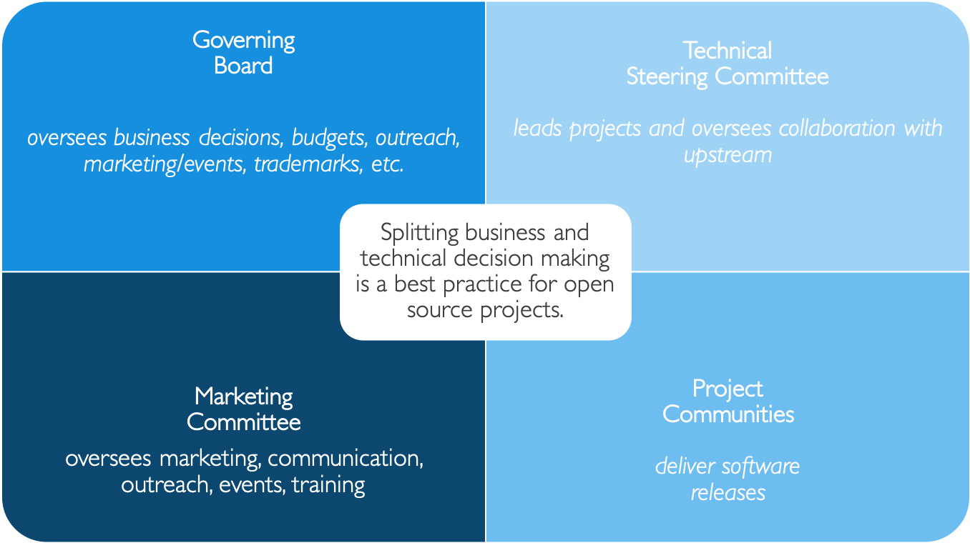
At the heart of LF Energy is Governance

Slide 46
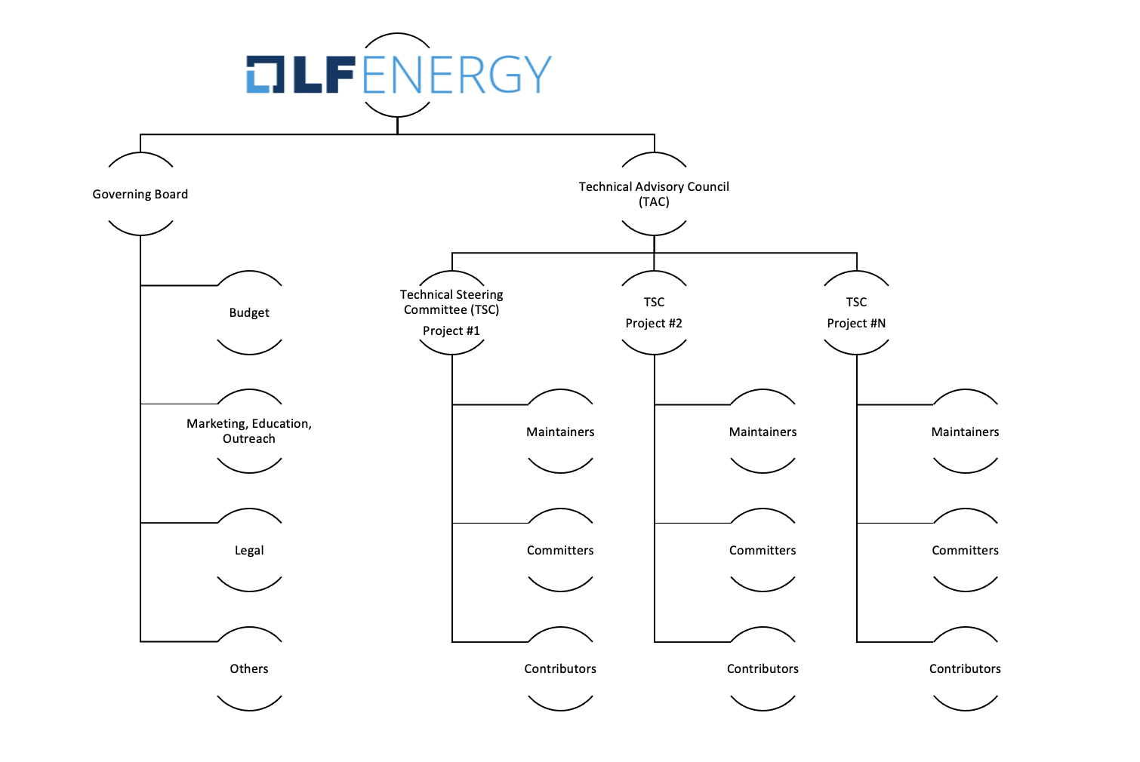
Governance Model

Slide 47
LF Energy Governance in Roles
A Technical Steering Committee (TSC) oversees each project. Each TSC has an elected Chair who both leads a project TSC and represents the concerns of a project to the Technical Advisory Committee (TAC). Participation on the TSC is based on merit, expertise, and contribution to the code or artifacts (e.g. testing, documentation) of the community.
Strategic Members can appoint 1 representative to a TSC for an initial 6-month basis to jump start engagement
Membership on a TSC thereafter is based on technical contribution—e.g., contributing a new project
A Technical Advisory Committee (TAC) addresses technical community concerns such as: new projects, release planning, cross-project collaboration, and documentation practices. The TAC is composed of the Chairs for each project TSC, plus a Governing Board representative to ensure alignment between technical and business concerns. There is an elected TAC Chair who represents the technical community on the Governing Board.
The Governing Board (GB) is limited to Strategic members and the elected TAC Chair. The GB determines allocation of funding to priorities and provides members with control over where their funding goes.
Strategic Members each appoint 1 representative
General Members can elect 1 representative for every 10 General Members, up to 3 total
Governing Board establishes additional committees to address topics (e.g. legal, marketing, budget)

Slide 48
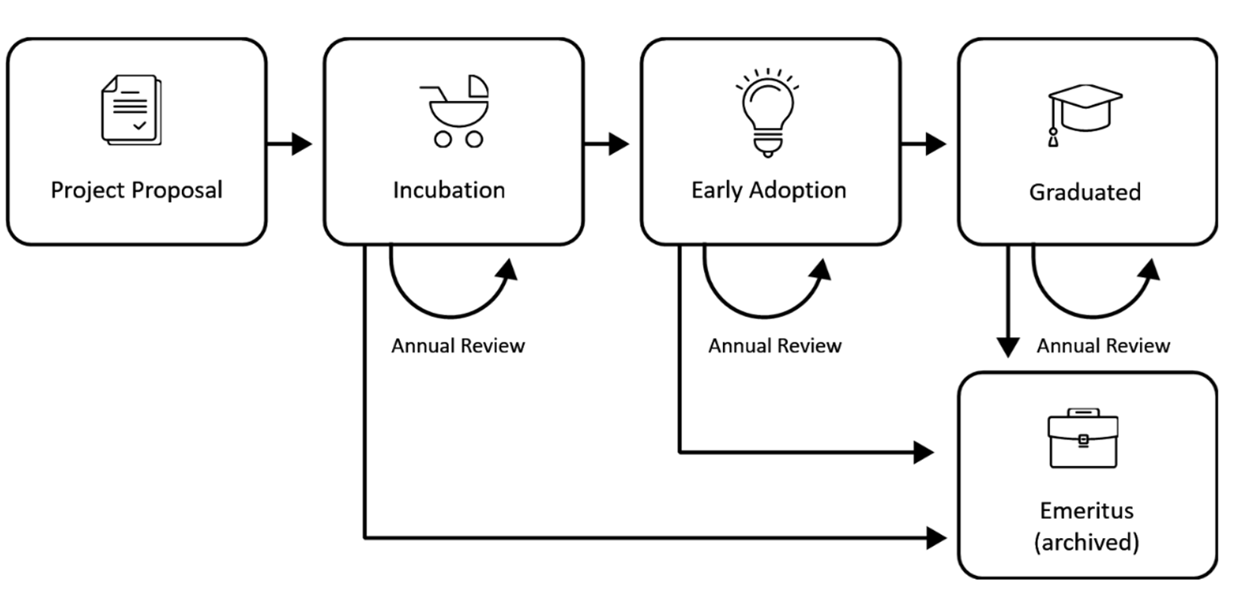
LF Energy Project Lifecycle
Projects can become part of LF Energy through the submission of a mature code base.
Projects can also be formed through special interests groups that submit a proposal and then form as an incubation project.
https://www.lfenergy.org/projects/host-your-project/
https://wiki.lfenergy.org/display/HOME/New+Project+Proposals+Process

Slide 49
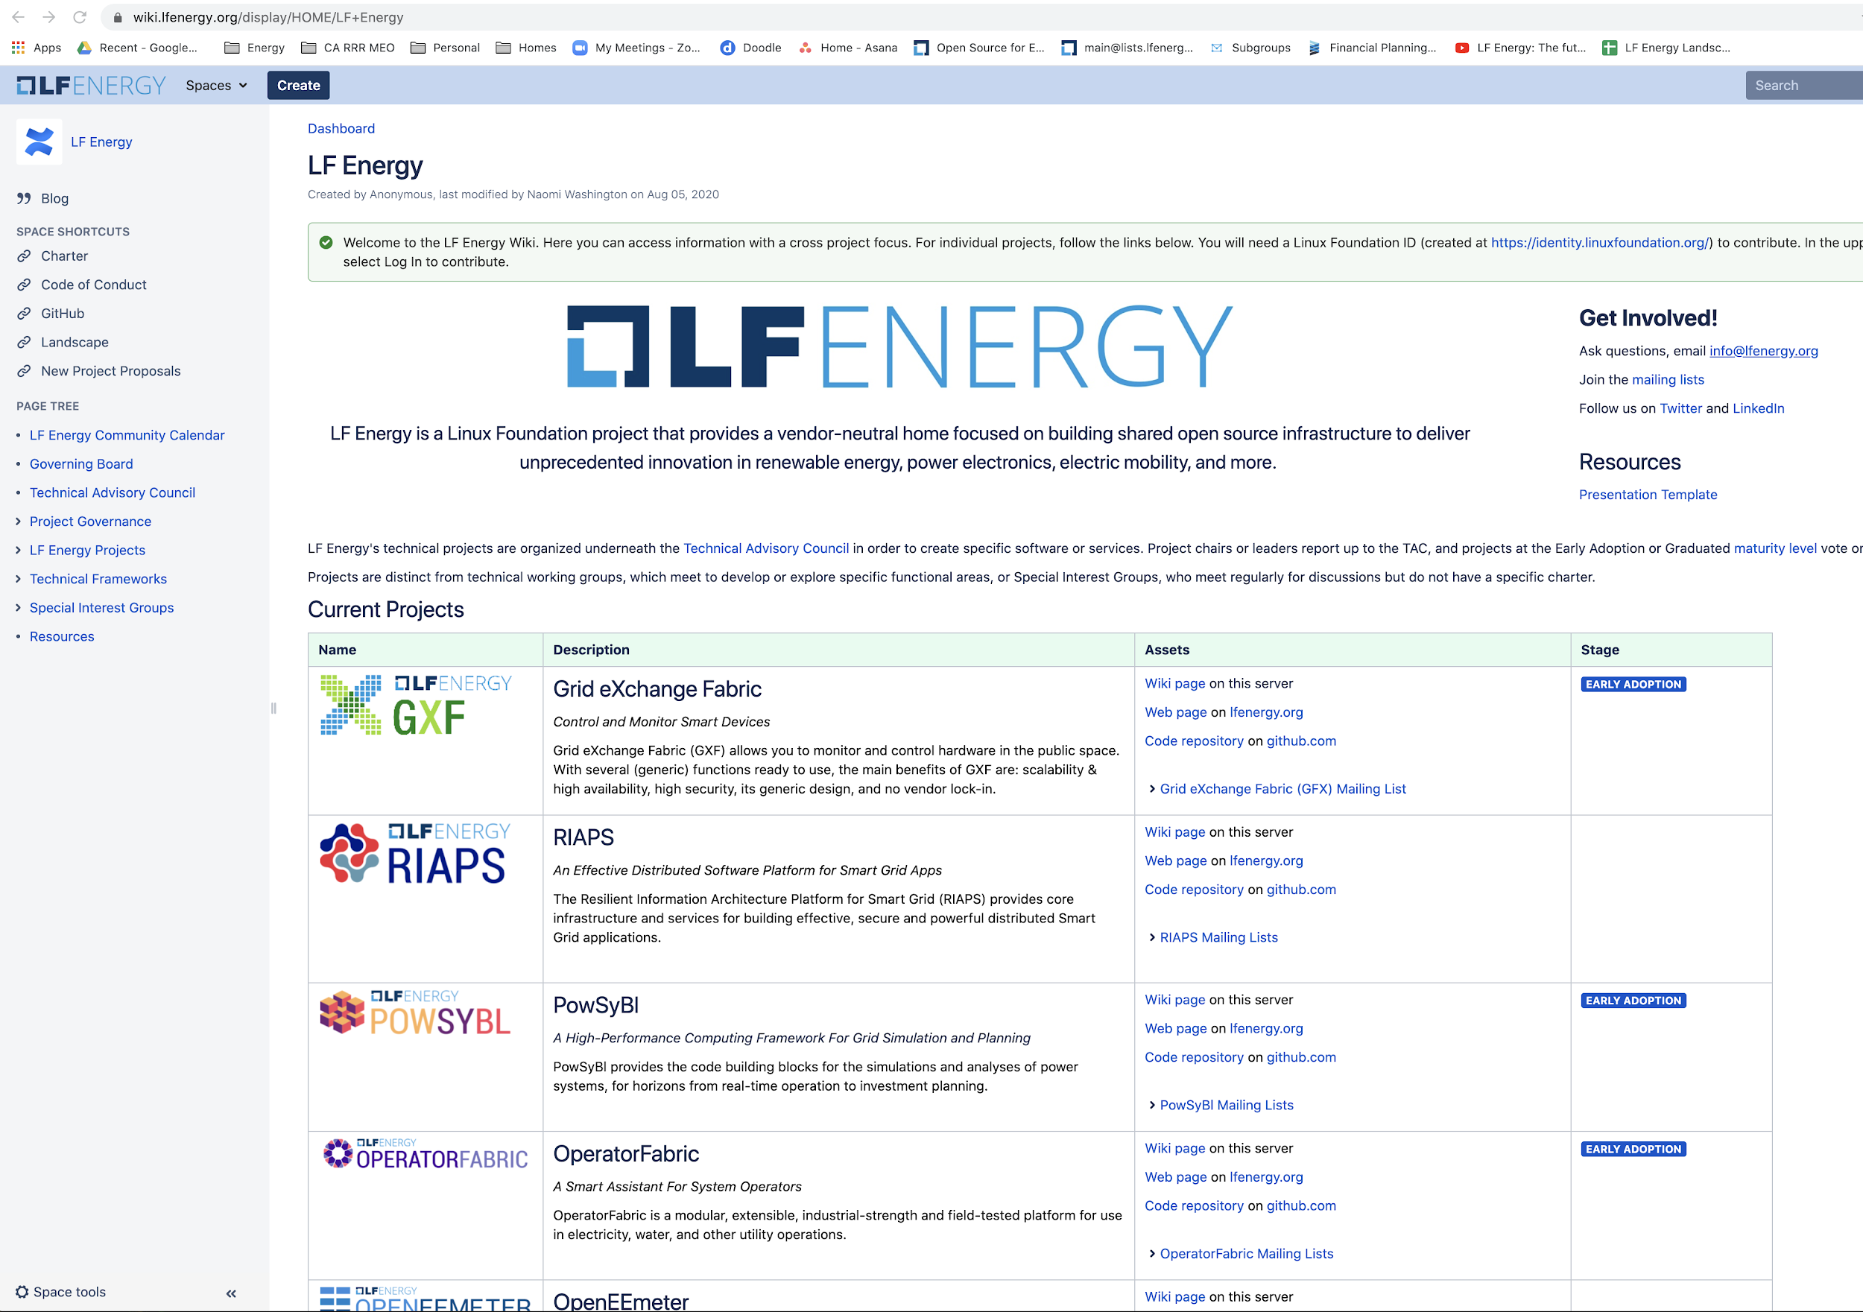
Transparency
All project governance documentation can be found at:
https://wiki.lfenergy.org/display/HOME/LF+Energy

Slide 50
Membership Model

Slide 51
Membership and Participation Levels
Membership Level | Annual Fee | Plus Linux Foundation Membership: Silver (if not a member) | Board Seat | TSC Seat | Outreach Committee | Suggested Minimum FTE* | Notes
Strategic | Flat fee: $150k | $20k | Yes | Yes | Yes | 1 | Two year minimum commitment
General | $5k-50k based on org size¹ | Based on number of employees $20K (5000+) $15K (499-4999) $10K (100-499) $5,000 (0-99) | (Possible) 1 per every 10 General members | Based on Merit | Yes | N/A | A TSC seat may be earned by technical contribution as a project leader
Associate | No fee | No | (Provisional at start-up) | Based on Merit | Yes | N/A | Limited to academic, research and NGO organizations
General Annual Fee Scale
$50K - > 5,000 employees
$30K - 1,000 – 4,999 employees $20K - 200 – 1,000 employees
$10K -100 – 200 employees
$5K -< 100 employees
* FTE = Full Time Equivalent (e.g. 2 employees each spend 50% of their time on a project). This suggestion is meant to provide a minimum resource investment to ensure members are contributing technically. Most projects see much higher investment of resources than the minimum requirement.

Slide 52
LF Energy Membership Benefits
Tier | New to LF | Existing LF member | Benefits
Strategic | $170,000 | $150,000 | Appoint one (1) voting representative to the LF Energy Governing Board. Appoint one (1) voting representative to the LF Energy Technical Advisory Council (TAC) Appoint one (1) representative as a voting member in any subcommittees or activities of the Governing Board. Enjoy most prominent placement in displays of membership including on the website and in marketing materials. 1 guest LF Energy blog post per quarter 1 LF Energy hosted webinar per quarter 1 Linux.com blog post per year 10 complementary LF Training course/certification tickets Create an individualized press release to announce membership with LF Energy PR. Receive greater insight into LF Energy strategy and project roadmaps through increased engagement with the LF Energy Executive Director and staff. Receive ongoing, monthly 1:1, individual engagement and guidance from LF Energy Executive Director Increased access to invitation-only Linux Foundation Member Summit. Receive discounts on LF Energy conferences + event sponsorship.
General | $70,000 (USD) 5,000+ $40,000 (USD) 2,000 – 4,999 $25,000 (USD) 500 – 1,999 $15,000 (USD) 100 – 499 $10,000 (USD) Up to 99 | $50,000 (USD) 5,000+ $25,000 (USD) 2,000 – 4,999 $10,000 (USD) 500 – 1,999 $5,000 (USD) 100 – 499 $5,000 (USD) Up to 99 | (Possible) Governing Board seat 1 per every 10 General and Academic and Research Institutions members collectively as a class, with a maximum of 3. 1 guest LF Energy blog post per year 1 LF Energy hosted webinar per year 10 complementary LF Training course/certification tickets Participate in all marketing, community, thought leadership opportunities. Receive discounts on LF Energy conferences + event sponsorship. Identify your organization as a member and display your logo on the LF Energy website and in marketing materials. Access to The Linux Foundation’s invitation-only Linux Foundation Member Summit.
Non-Profit | $1,000 | $1,000 | The Non-Profit category of membership is limited to non-profit/non-governmental organizations. This requires approval by the Governing Board. Participate in all marketing, community, thought leadership opportunities. Receive discounts on LF Energy event sponsorship. Identify your organization as a member and display your logo on the LF Energy website and in marketing materials.

Slide 53
For Further Information
Shuli Goodman
Executive Director Linux Foundation Energy sgoodman@lfenergy.org
Our Website: https://lfenergy.org
Membership: https://www.lfenergy.org/join
Mailing Lists: https://lists.lfenergy.org
Our Wiki: https://wiki.lfenergy.org

